Slide 1
Recommendation System
By Deborah Kewon
Sample

Slide 2
Contents
Collaborative Filtering Model
Hybrid Model
Model Benchmarking
Further Steps
Sources
Objective
Data
Evaluation Metrics
Popularity Model
Content-based Model

Slide 3
Objective
The purpose of this project is to…
Increase the convenience/satisfaction level of customers by filtering, prioritizing and recommending only relevant items that customers may be interested in ( good CRM)
Prevent the problem of information overload in retails
Provide personalized services, which lead to high response and retention rates (potential increase in revenue)

Slide 4
Data
2018, Store F378, Implicit Data using Purchase History
Basetable includes contact, order and product information
221 558 observations
58 829 unique customers
Used customers with more than 3 interactions: customers who bought 3 or more products
141 011 observations
24127 unique customers
112 808 (80%) train set and 28 203 (20%) test set

Slide 5
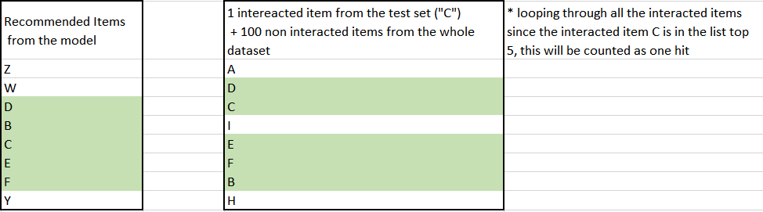
Evaluation Metrics: TOP-N Accuracy
Top 5: first 5 (consecutive) items that are both in the recommended item list and the evaluation set
Top 10: first 10 (consecutive) items that are both in the recommended item list and the evaluation set

Slide 6
Popularity Model
Sample

Slide 7
Popularity Model
This model recommends the most popular items- highest number of sales across customers
Popularity model is usually non- personalized. The model can recommend items that a customer already purchased.
However, for our case, the model will recommend the most popular items, excluding the items that a customer already purchased.

Slide 8
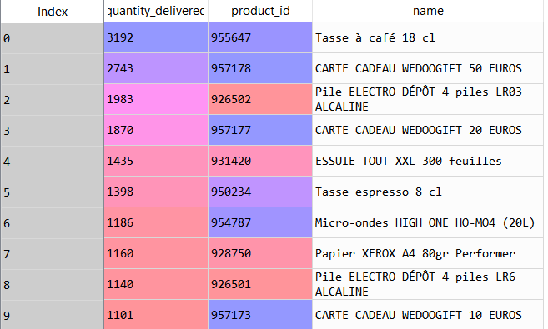
Popularity Model
Given that contact ID = ce79b261daa9c170604d11d6fc4e7b0ee6fa6038 (train:136 items; test:34 items )
These are the recommended items from the popularity model for this customer
This recommended item list doesn’t include the items that the customer already purchased
The recommended items are slightly different from customer to customer based on his purchase history
* We can also make it completely non-personalized by not taking purchased items into consideration

Slide 9
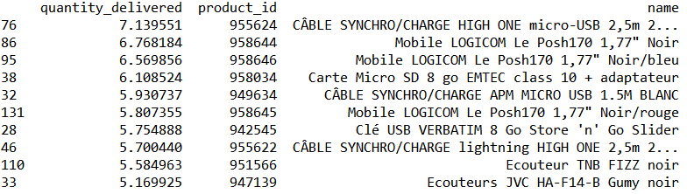
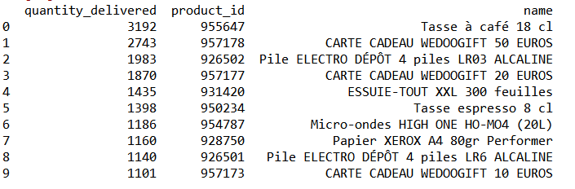
Popularity Model Example
Items (in the train set) purchased by the customer(ce79b261daa9c170604d11d6fc4e7b0ee6fa6038 )
Recommended Items from the popularity model (excluding the items that the customer already purchased)

Slide 10
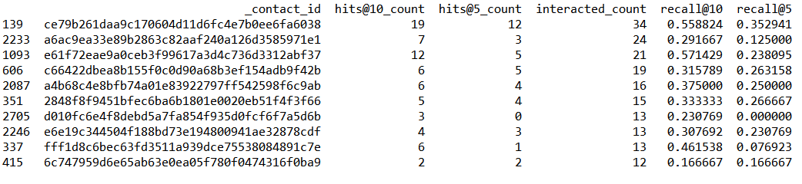
Popularity Model
Given that contact ID = ce79b261daa9c170604d11d6fc4e7b0ee6fa6038
35% of the interacted items (test set) are in the top 5 recommended item list
56 % of the interacted items (test set) are in the top 10 recommended item list.
Notes:
https://ils.unc.edu/courses/2013_spring/inls509_001/lectures/10-EvaluationMetrics.pdf
https://stackoverflow.com/questions/33697625/recall-recall-ratek-and-precision-in-top-k-recommendation
https://towardsdatascience.com/evaluating-a-real-life-recommender-system-error-based-and-ranking-based-84708e3285b
https://medium.com/@m_n_malaeb/recall-and-precision-at-k-for-recommender-systems-618483226c54
Maybe i should set k and count only the intersection= intersection between relevant doc and retrieved doc/relevant doc
hits@10_count= in order to have 10 items right, you need to go through 19 items
hits@5_count= in order to have 5 items right, you need to go through 12 items --wrong because how can it be 2?
https://stackoverflow.com/questions/37668902/evaluation-calculate-top-n-accuracy-top-1-and-top-5

Slide 11
Popularity Model
In general, 29% of interacted items in the test set made to the top 5 in the recommended item list.
In general, 43% of interacted items in the test set made to the top 10 In the recommended item list.

Slide 12
Collaborative Filtering Model
Sample

Slide 13
Collaborative Filtering Model
If a person A has the same opinion as a person B on a set of items, A is more likely to have B's opinion for a given item than that of a randomly chosen person.
SVD (Singular Value Decomposition) Matrix Factorization used
Columns:Product IDs, Rows: Contact IDs, Values: Quantity Delivered

Slide 14
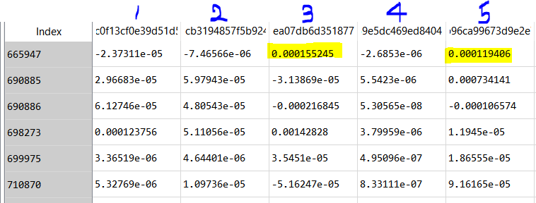
Collaborative Filtering Model
The above data frame is the result of SVD matrix factorization. As you can see, customer 1,2 and 4 are less passionate about product 665947 than customer 3 and 5. We can predict the preferences of a customer based on those of other customers who are in his group.

Slide 15
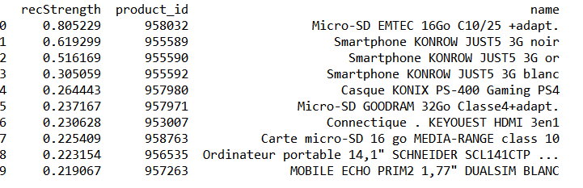
Collaborative Filtering Model
Purchased Items of this customer (ce79b261daa9c170604d11d6fc4e7b0ee6fa6038)
Recommended items based on the purchase history of other customers

Slide 16
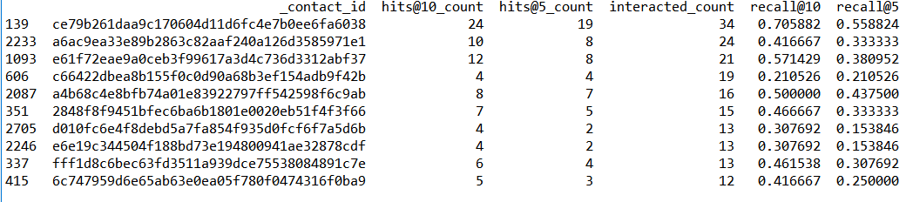
Collaborative Filtering Model
Given that contact ID = ce79b261daa9c170604d11d6fc4e7b0ee6fa6038
56% of the interacted items (test set) made to the top 5 in the recommended item list
71 % of the interacted items (test set) made to the top 10 in the recommended item list.

Slide 17
Collaborative Filtering Model
In general, 29% of interacted items in the test set made to the top 5 in the recommended item list
In general, 43% of interacted items in the test set made to the top 10 in the recommended item list

Slide 18
Content-based Model
Sample

Slide 19
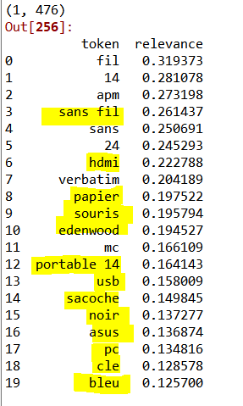
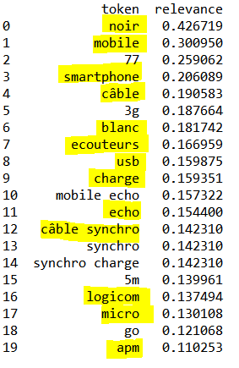
Content-based Model
Extract words that appear most frequently in the purchase history
The number of total words: 476
See which word has the high relevance with the user and recommend items with these words
ex1)89c06d195f7d44b6726611a8b0ff59440d992a16 (contact ID for customer 1)
ex2)ce79b261daa9c170604d11d6fc4e7b0ee6fa6038(contact ID for customer 2)

Slide 20
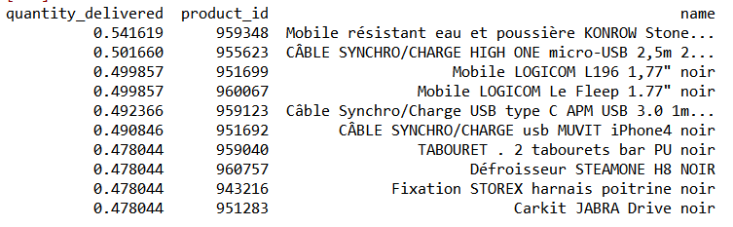
Content-based Model
Items (in the train set) purchased by the customer(ce79b261daa9c170604d11d6fc4e7b0ee6fa6038 )
Recommended items from the content based model

Slide 21
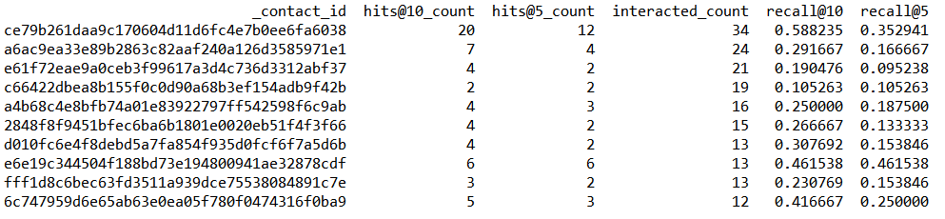
Content-based Model
Given that contact ID = ce79b261daa9c170604d11d6fc4e7b0ee6fa6038
35% of the interacted items (test set) made to the top 5 in the recommended item list
59 % of the interacted items (test set) made to the top 10 in the recommended item list.

Slide 22
Content-based Model
On average, 21% of interacted items in the test set made to the top 5 in the recommended item list
On average, 29% of interacted items in the test set made to the top 10 in the recommended item list
Even though the accuracy of content-based model is relatively low, it can be useful for customers who have strong preferences for certain brands/products

Slide 23
Hybrid Model
Sample

Slide 24
Hybrid Model (Popularity Model + Collaborative Filtering Model)
Combined both popularity and collaborative filtering models
Multiply popularity score and CF score and rank the results
May solve the issues of cold start and sparsity

Slide 25
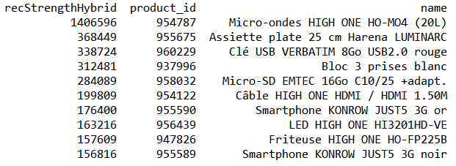
Hybrid Model
Items (in the train set) purchased by the customer(ce79b261daa9c170604d11d6fc4e7b0ee6fa6038 )
Recommended items from the hybrid model
Notes:
Popularity model itself is actually better regardless...

Slide 26
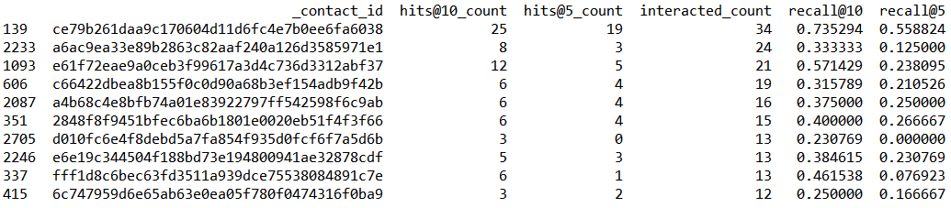
Hybrid Model
Given that contact ID = ce79b261daa9c170604d11d6fc4e7b0ee6fa6038
56% of the interacted items (test set) made to the top 5 in the recommended item list
74 % of the interacted items (test set) made to the top 10 in the recommended item list.

Slide 27
Hybrid Model
On average, 29% of interacted items in the test set made to the top 5 in the recommended item list.
On average, 42% of interacted items in the test set made to the top 10 in the recommended item list.

Slide 28
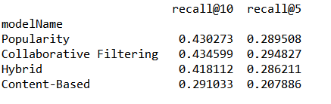
Model Benchmarking: Which model is most accurate?
The accuracy slightly changes with the random split
Collaborative Filtering Model is the most accurate model given our current data. However, this may change based on the data size.

Slide 29
Further Steps
1 year 1 store Data on the local environment (Spyder)
Find the AI Platform
Apply the code to the bigger dataset on the selected AI platform
Wrap-up
Implementa-tion
Wrap-up: feedback session, troubleshooting, file conversion (into json if needed)

Slide 30
Sources
https://www.kaggle.com/gspmoreira/recommender-systems-in-python-101
https://machinelearningmastery.com/singular-value-decomposition-for-machine-learning
https://ils.unc.edu/courses/2013_spring/inls509_001/lectures/10-EvaluationMetrics.pdf
https://stackoverflow.com/questions/33697625/recall-recall-ratek-and-precision-in-top-k-recommendation
https://towardsdatascience.com/evaluating-a-real-life-recommender-system-error-based-and-ranking-based-84708e3285b
https://medium.com/@m_n_malaeb/recall-and-precision-at-k-for-recommender-systems-618483226c54
https://stackoverflow.com/questions/37668902/evaluation-calculate-top-n-accuracy-top-1-and-top-5

Slide 31
Thanks!
Any questions ?

